Slide 1

<EPAM> Training final project “JCasino Slots”

Slide 2

Application features
Player:
Registration, login/logout;
3-step identity verification (profile, e-mail, passport scan);
Technical support;
Edit profile;
View stats;
View account data;
Replenish/withdraw money;
Take/pay loan;
View operation history;
Play slots.

Slide 3
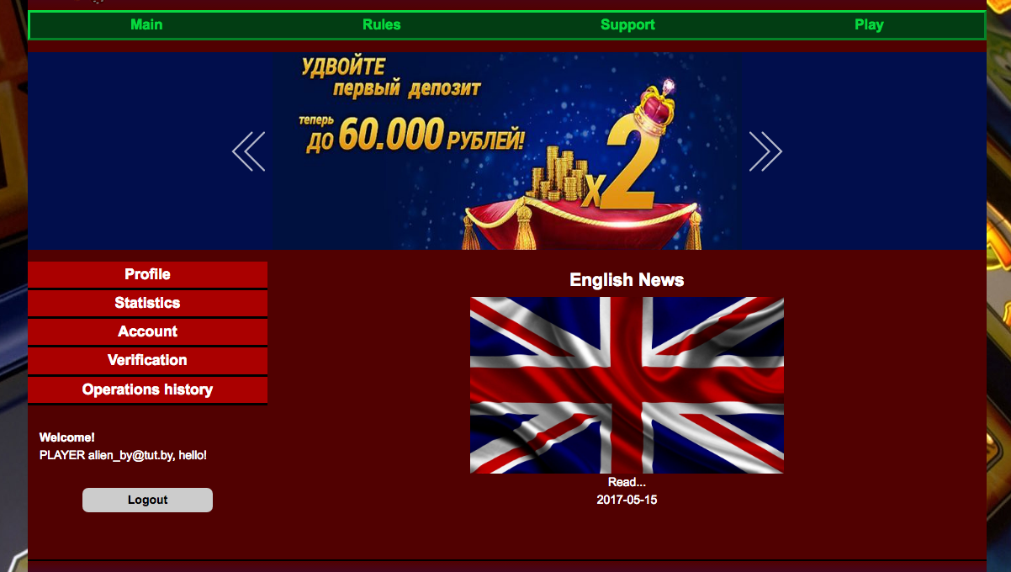
Player interface

Slide 4

Application features
Admin:
Login/logout;
Add/edit/delete news;
Verify player (with comments);
Technical support administration;
View player operation history;
View player data;
Change player status (with comments).

Slide 5
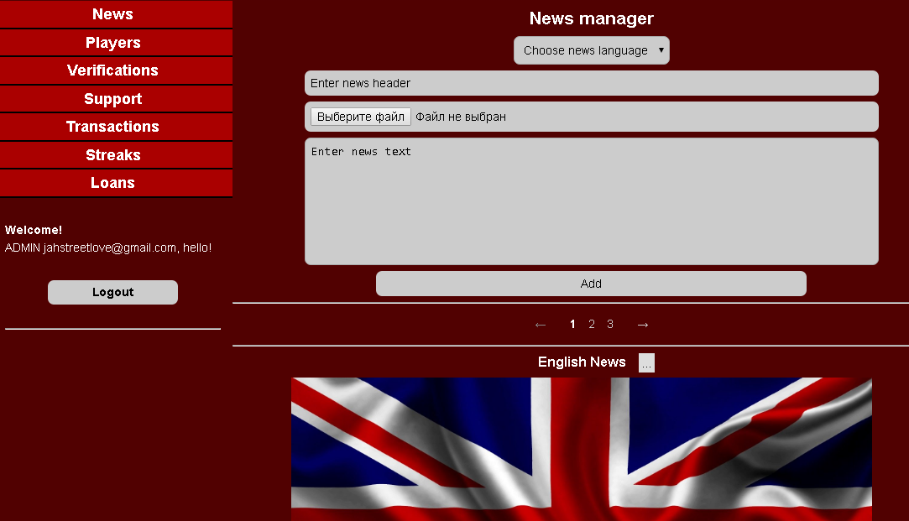
Admin interface

Slide 6
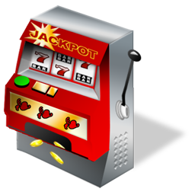
Application features
Game:
Spin;
View/choose playing lines;
Choose bet amount;
Choose each reel offset;
Finish streak;
Keyboard control bindings;
Turn on/off music and sound design;
“Demo” and “For real money” play modes;
MD5 Fairness Check “FairPlay”.

Slide 7
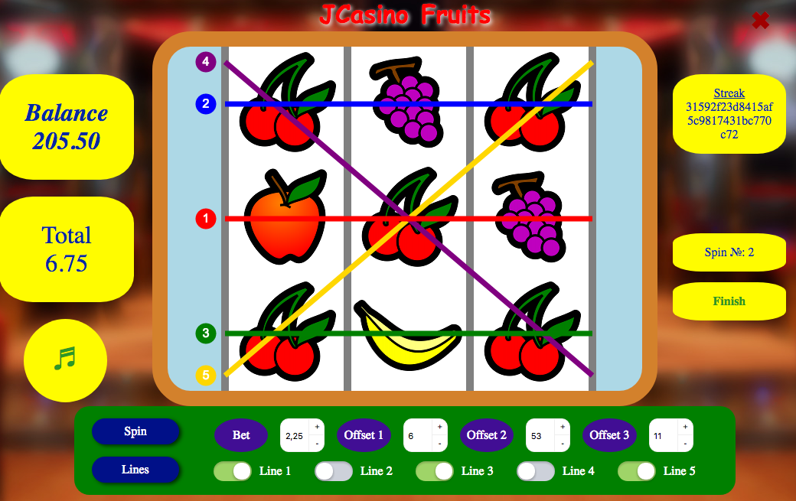
Game interface

Slide 8

Application features
Security:
User role control;
Page update scenario control;
Custom user navigation prevention;
SQL injection protection;
JavaScript injection protection;
Other security features.

Slide 9

Application features
Common:
Multi-language content and message support (Ru/En);
Support for mobile devices with small screens;
News feed;
Pagination support;
File upload support;
View data filters.

Slide 10
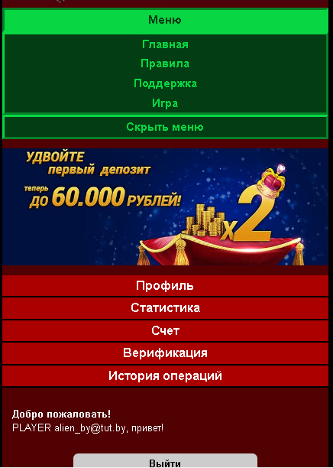
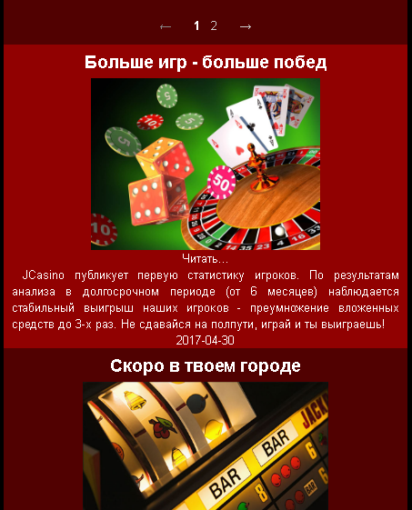
Mobile interface

Slide 11



Used technologies
Application architecture: Client – Server – DB.
Request
Response
SQL query
Client
(Web Browser)
Tomcat App Server
MySQL RDMS

Slide 12
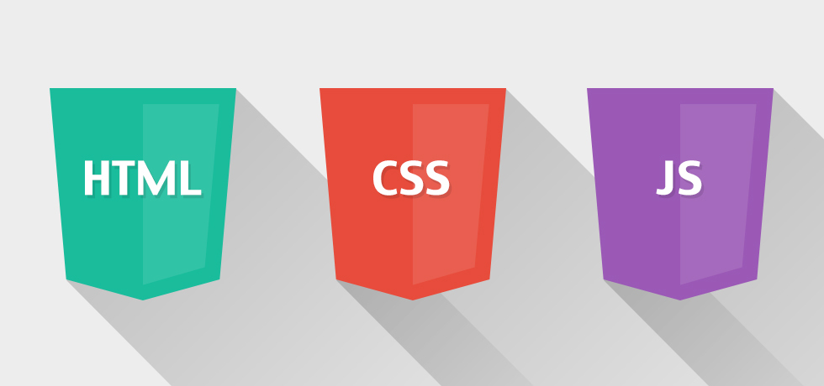
Used technologies
Front-end:
Pure HTML5, CSSS3, JavaScript, responsive design;
jQuery;
jPages pagination and other libraries and jQuery plugins;
Game engine using AJAX, Canvas animation, JS;
Form validation.

Slide 13


Used technologies
Database:
MySQL RDMS;
JDBC database access;
Self-written singleton connection pool;
Stored SQL procedures.

Slide 14
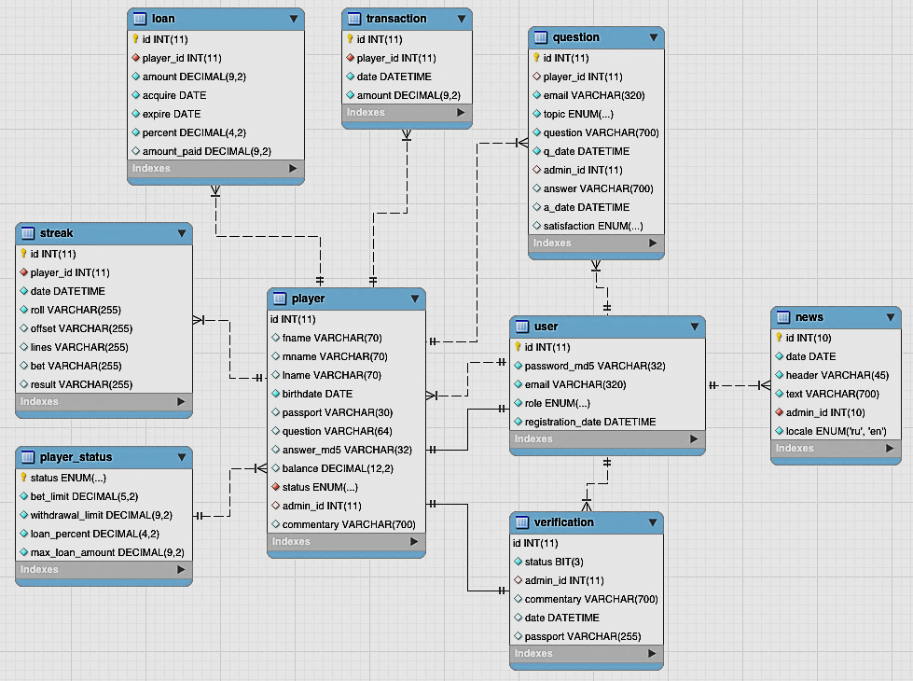
Database structure

Slide 15
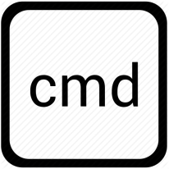




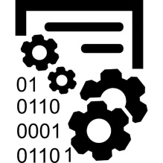

Server-side model
Tomcat Application Server
Command
Service
Connection Pool
Retrieve and validate request params, process request data
Take connection
Servlet Container
Execute defined command to take navigation data
Process business logic, modify data for database call
Filters
Controller
DAO
Listeners
Database call, process queries
Request
Response
MySQL RDMS

Slide 16


Used technologies
Server-side:
Tomcat Application Server;
Servlet&JSP (JSTL, EL, WebFilter, WebListener);
Java 8 features;
Java Mail;
Third-party Java libraries;
Request data validation.

Slide 17


Used technologies
Other:
Intellij IDEA;
Log4j2;
Maven;
Local and remote deployment settings (Jelastic platform);
Git;
JavaDoc;
Fail-safe and scalability features.

Slide 18


Used technologies
Test:
Junit 4;
Mockito, PowerMockito;
DBUnit;
Code coverage tools.

Slide 19
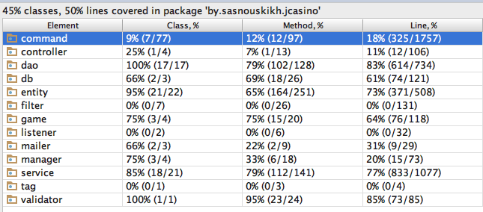
Test code coverage

Slide 20

Used design patterns
Singleton (Connection pool);
Factory (Command factory);
Wrapper (Wrapped connection);
Chain of responsibility (WebFilters);
MVC Layered architecture;
Controller;
Command;
DAO;
AOP features (eg Request logging);
Lazy initialization (DAOHelper#getDAOinstance);
PRG (Navigation/F5-protection);
ACID transaction system (database transactions);
Other.

Slide 21

Hire me NOW!
Phone: +375 (33) 653-21-15 (Aliaksandr)
E-mail: jahstreetlove@gmail.com
Skype: cocha_tz
VK: http://vk.com/id19015905
GitHub: https://github.com/jahstreet/JCasino
BitBucket: https://bitbucket.org/jahstreet/jcasino/src
Deployed project: http://jcasino.mycloud.by/
Want to make your team even stronger – just call me;)

